Slide 1
Applications of Graph 1. Shortest Paths 2. Minimum Spanning Trees

Slide 2
Shortest Paths
Problem: Given some vertex s, find the shortest path from s to every other vertex in G.
Suppose we have a weighted graph G:
The cost of traversing edge (i, j) is c_{i,j} .
The cost of traversing a path is the sum of the edge costs.

Slide 3
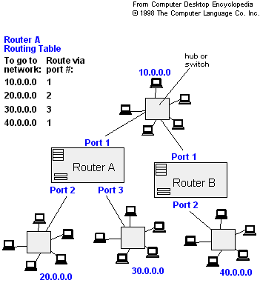
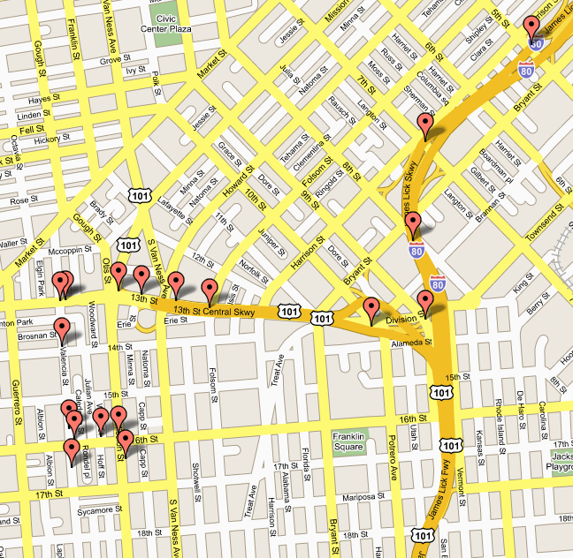
Applications
Phone/Internet communications: to find the cheapest/fastest path between two computers.
Transportation/Travelling: to find the cheapest/fastest path between two cities.

Slide 4
Shortest Path Example

Slide 5
Dijkstra’s Algorithm

Slide 6
Dijkstra’s Algorithm
Set initial distances for all vertices: 0 for the source vertex, and infinity for all the other.
Choose the unvisited vertex with the shortest distance from the start to be the current vertex. So the algorithm will always start with the source as the current vertex.
For each of the current vertex's unvisited neighbor vertices, calculate the distance from the source and update the distance if the new, calculated, distance is lower.
We are now done with the current vertex, so we mark it as visited. A visited vertex is not checked again.
Go back to step 2 to choose a new current vertex, and keep repeating these steps until all vertices are visited.
In the end we are left with the shortest path from the source vertex to every other vertex in the graph.

Slide 7
Dijkstra pseudocode
Dijkstra(v1, v2):
for each vertex v: // Initialization
v's distance := infinity.
v's previous := none.
v1's distance := 0.
List := {all vertices}.
while List is not empty:
v := remove List vertex with minimum distance.
mark v as known.
for each unknown neighbor n of v:
dist := v's distance + edge (v, n)'s weight.
if dist is smaller than n's distance:
n's distance := dist.
n's previous := v.
reconstruct path from v2 back to v1,
following previous pointers.

Slide 8
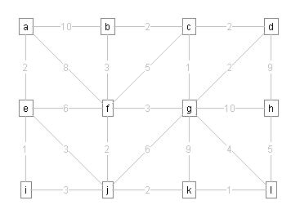

Slide 9
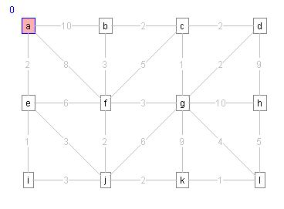
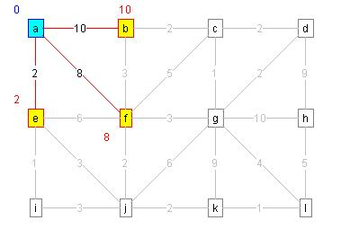
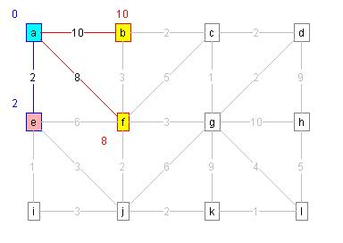

Slide 10
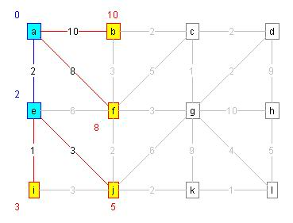
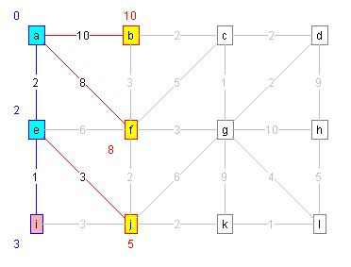
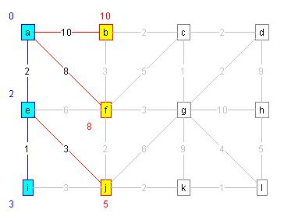
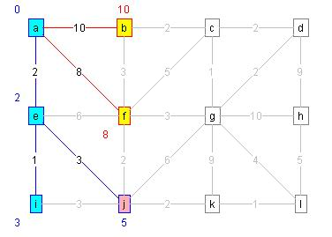

Slide 11
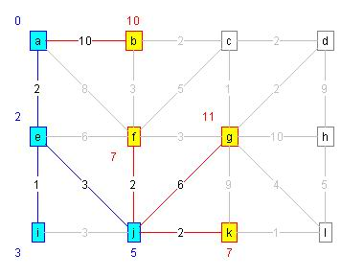
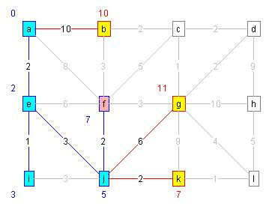
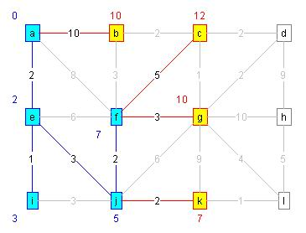
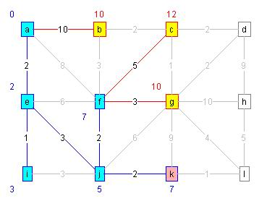

Slide 12
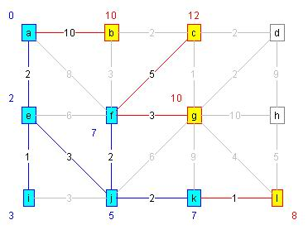
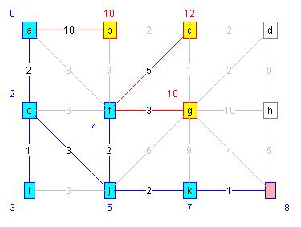
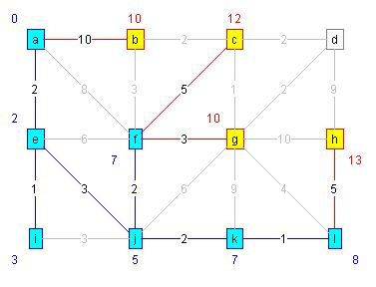
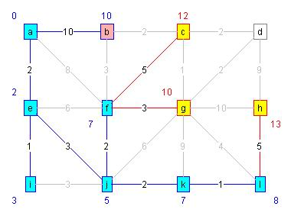

Slide 13
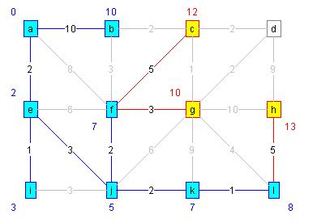
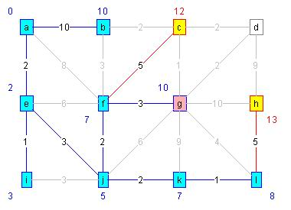
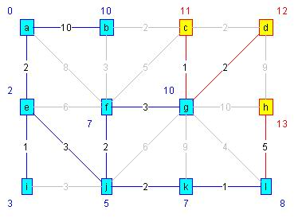
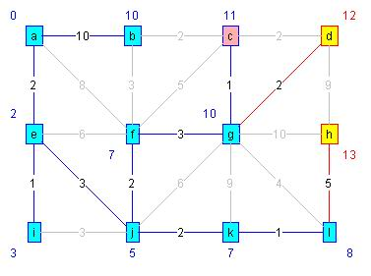

Slide 14
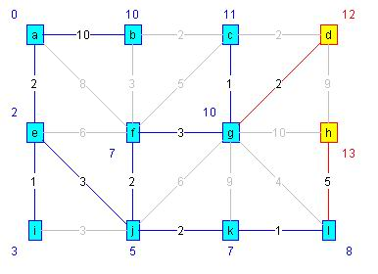
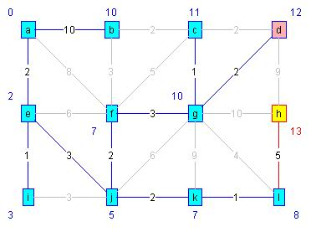
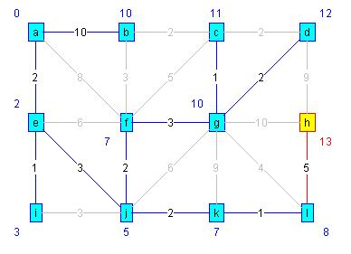
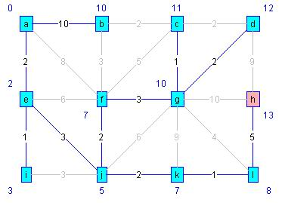

Slide 15
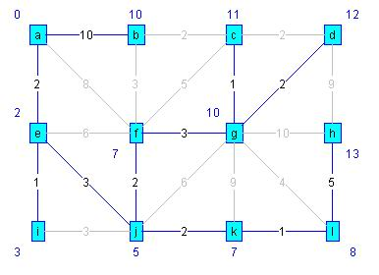

Slide 16
Example II
Find shortest distances from v1 to all other vertices.
2
v1
v2
10
1
3
4
2
2
v4
v5
v3
8
4
5
6
v6
v7
1

Slide 17
Example
2
v1
v2
0
10
1
3
4
2
2
v4
v5
v3
8
4
5
6
v6
v7
1
Let’s start at v1, with path length 0. Now we look
at nodes adjacent to v1: v2 and v4. We are done with v1.

Slide 18
Example
2
v1
v2
2
0
10
1
3
4
2
2
v4
v5
v3
1
8
4
5
6
v6
v7
1
Of the undone vertices, v4 has the lowest path length.
We have to look at adjacent vertices: v3, v5, v6, v7.
We are now done with v4.

Slide 19
Example
v1
2
v2
0
2
10
1
3
4
2
2
v4
v5
v3
3
1
8
3
4
5
6
v6
v7
9
1
5
Of the undone vertices, v2 has the lowest path length.
We have to look at adjacent vertices: v4, v5. We are
done with v4. Also, since 2+10 > 3, we don’t update v5.
We are now done with v2.

Slide 20
Example
v1
2
v2
0
2
10
1
3
4
2
2
v4
v5
v3
3
1
8
3
4
5
6
v6
v7
9
1
5
Of the undone vertices, v5 has a lowest path length.
We have to look at adjacent vertex: v7. Since 3+6 > 5,
we don’t update v7. We are now done with v5.

Slide 21
Example
v1
2
v2
0
2
10
1
3
4
2
2
v4
v5
v3
3
1
8
3
4
5
6
v6
v7
8
1
5
Of the undone vertices, v3 has a lowest path length.
We have to look at adjacent vertices: v1, v6. We are done
with v1. We update v6, since 3+5 < 9. We are now done with v3.

Slide 22
Example
v1
2
v2
0
2
10
1
3
4
2
2
v4
v5
v3
3
1
8
3
4
5
6
v6
v7
6
1
5
Of the undone vertices, v7 has the lowest path length.
We have to look at adjacent vertex: v6. We update v6,
since 5+1 < 8. We are now done with v7.

Slide 23
Example
v1
2
v2
0
2
10
1
3
4
2
2
v4
v5
v3
3
1
8
3
4
5
6
v6
v7
6
1
5
Only v6 is left. It has no adjacent vertices. We are done.
We can also use a table to represent this algorithm…

Slide 24
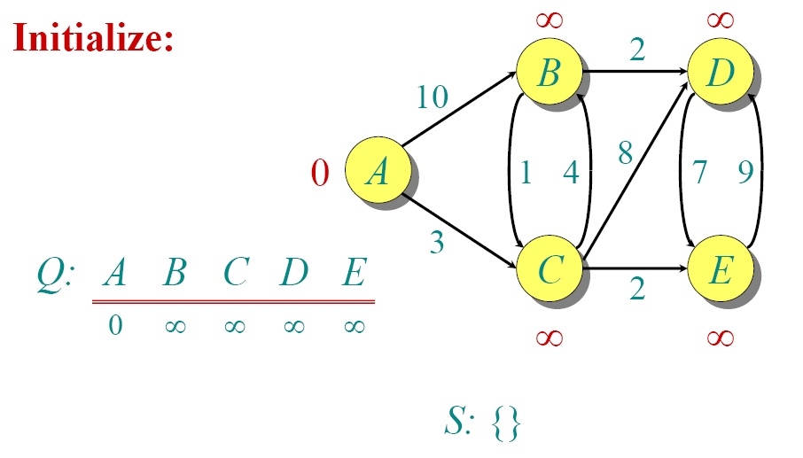
Dijkstra Animated Example

Slide 25
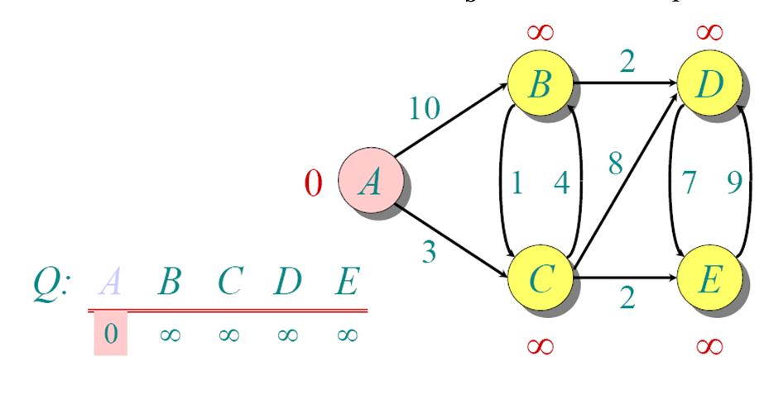
Dijkstra Animated Example

Slide 26
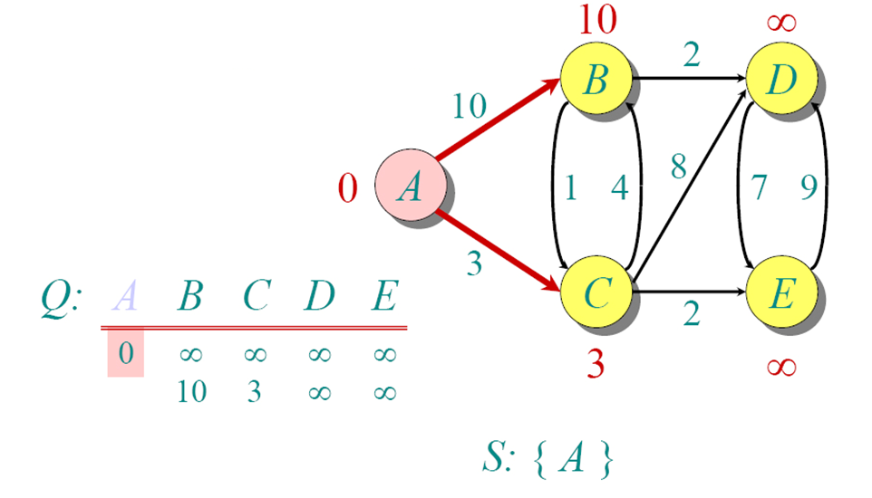
Dijkstra Animated Example

Slide 27
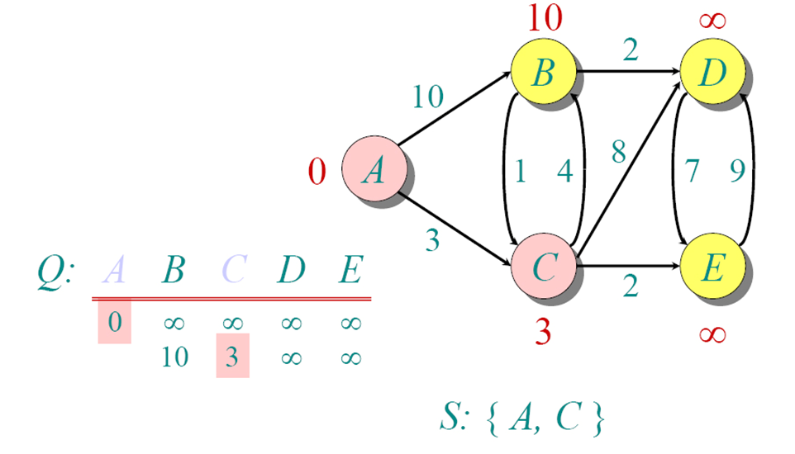
Dijkstra Animated Example

Slide 28
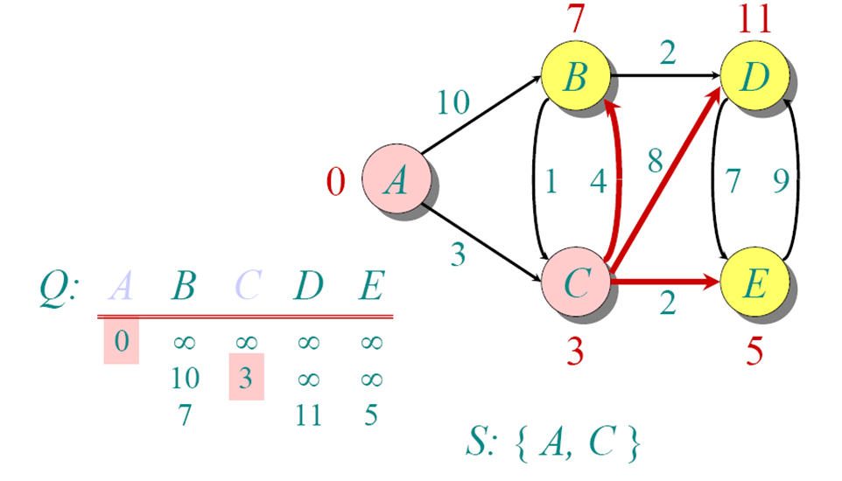
Dijkstra Animated Example

Slide 29
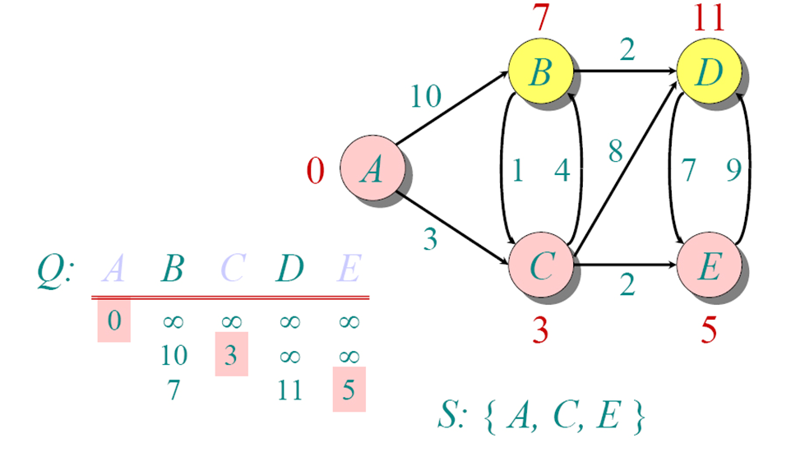
Dijkstra Animated Example

Slide 30
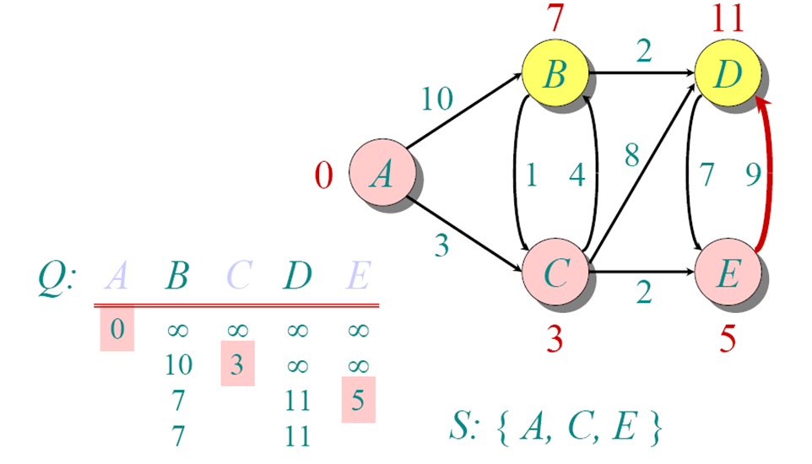
Dijkstra Animated Example

Slide 31
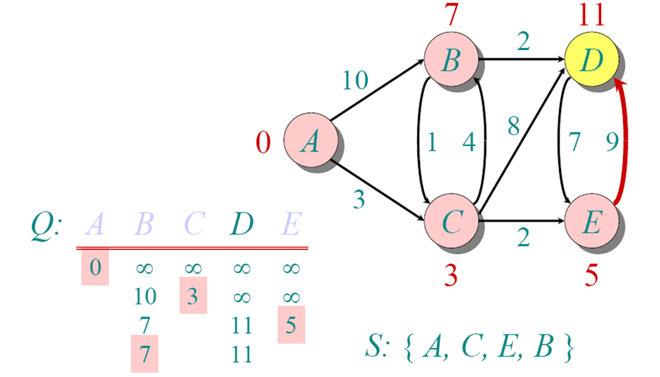
Dijkstra Animated Example

Slide 32
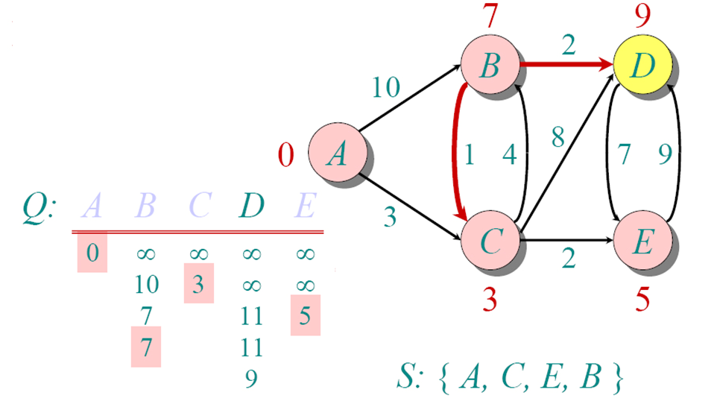
Dijkstra Animated Example

Slide 33
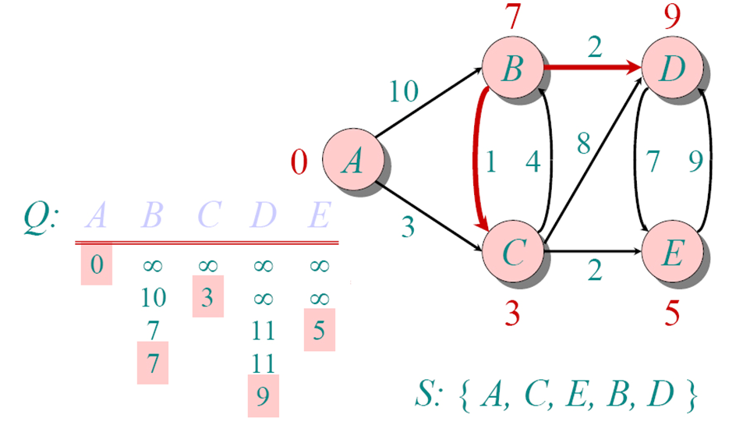
Dijkstra Animated Example

Slide 34
Dijkstra’s Algorithm - Example
1
10
2
3
9
4
6
5
7
2

Slide 35
Dijkstra’s Algorithm - Example
1
∞
∞
10
2
3
9
0
4
6
5
7
∞
∞
2

Slide 36
Dijkstra’s Algorithm - Example
1
10
∞
10
2
3
9
0
4
6
5
7
5
∞
2

Slide 37
Dijkstra’s Algorithm - Example
1
10
∞
10
2
3
9
0
4
6
5
7
5
∞
2

Slide 38
Dijkstra’s Algorithm - Example
1
8
14
10
2
3
9
0
4
6
5
7
5
7
2

Slide 39
Dijkstra’s Algorithm - Example
1
8
14
10
2
3
9
0
4
6
5
7
5
7
2

Slide 40
Dijkstra’s Algorithm - Example
1
8
13
10
2
3
9
0
4
6
5
7
5
7
2

Slide 41
Dijkstra’s Algorithm - Example
1
8
13
10
2
3
9
0
4
6
5
7
5
7
2

Slide 42
Dijkstra’s Algorithm - Example
1
8
9
10
2
3
9
0
4
6
5
7
5
7
2

Slide 43
Dijkstra’s Algorithm - Example
1
8
9
10
2
3
9
0
4
6
5
7
5
7
2

